Slide 1
Unit 210: Understand how to communicate with others within building services engineering
Information in the workplace

Slide 2
Information in the workplace
Job specification
Installation specifications give complete details of what is to be included in the installation, including plans.
They will give details of the equipment to be installed, where it is to be installed, sizes, etc.
This will allow the contractor to calculate material, labour and plant requirements, thus enabling them to put together an accurate costing to carry out the job.
The price for the job – ie how much the customer will be charged – will be calculated according to the costing, plus the desired profit margin.

Slide 3
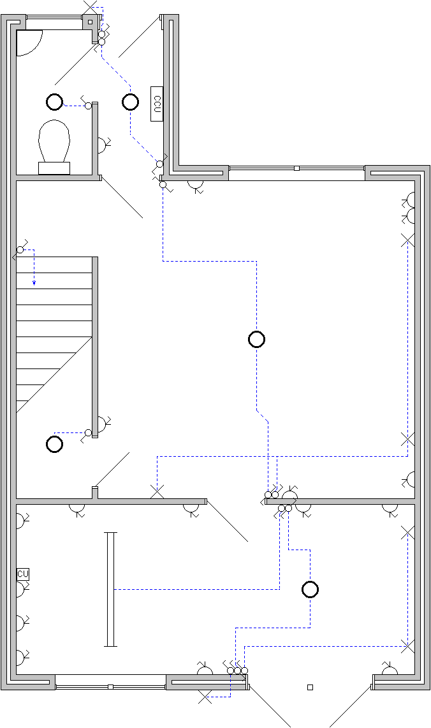
Information in the workplace
Plans/drawings
Architectural plans are the ones most likely to be encountered by the contractor.
They show the layout of the building, and the position of accessories and equipment using standard symbols.
At the design stage, the contracting company will receive the plans, along with the specification.

Slide 4
Information in the workplace
Plans/drawings (continued)
This will show on a scale drawing the position of all accessories and equipment, and will allow the designer to determine the material requirements for the job, and hence accurate costing.
During the installation phase, the installer will use the scale architectural plans to position accessories and equipment accurately.

Slide 5
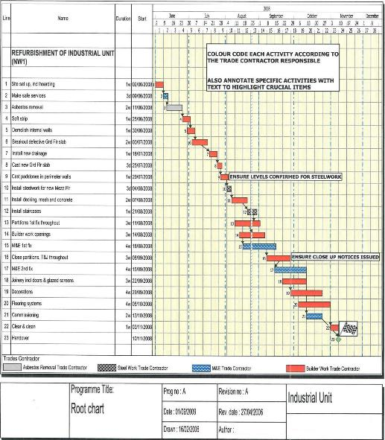
Information in the workplace
Work programmes
This shows the progress of the work on site, indicating a clear start and finish date for each of the trades, and the activities they should be doing (Time-Activity).

Slide 6
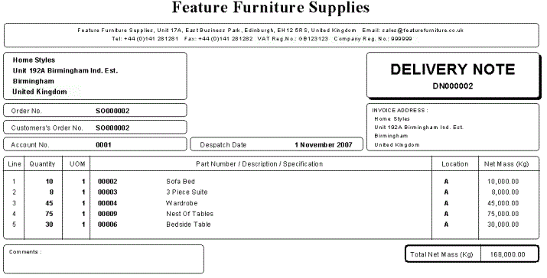
Information in the workplace
Delivery notes
Document accompanying a shipment of goods, that lists the description and quantity of the goods delivered.
A copy of the delivery note, signed by the buyer or consignee, is returned to the seller, or consignor, as a proof of delivery.

Slide 7
Information in the workplace
Timesheets
These are completed by individual employees on a weekly basis. They contain details of hours worked, description of work carried out and at which site.
They are used to calculate wages and also for future estimates.

Slide 8
Information in the workplace
Policy documentation
Health and safety policy
Describes how a company will manage health and safety in their business and will let staff and others know about the commitment to health and safety. This will be the company health and safety policy. It should clearly say who does what, when and how.
If a company has five or more employees, it must have a written policy.
The policy does not need to be complicated or time-consuming.
A policy will only be effective if you and your staff follow it and review it regularly.

Slide 9
Information in the workplace
Policy documentation
Environmental policy
An environmental policy statement is the communication of your policy internally within your organisation and externally to your customers and suppliers.
Once you have understood the principles involved and have accepted responsibility for the pollution generated by your company, the first step on the journey towards sustainability is to create a written commitment in the form of an Environmental Policy Statement.
This should acknowledge the reasons for the policy, be specific and achievable, and clearly written for an audience of staff, suppliers, customers and general public.
It must be signed by a senior executive to demonstrate that it is a Company Policy and should be reviewed at regular intervals.

Slide 10
Information in the workplace
Policy documentation
Customer service policy
These days most organisations have a customer service policy. This is because customer care is becoming more important, as companies strive for better customer engagement.
It is important that the customer understands what he or she can expect in terms of service, and a customer service policy can communicate this very well.
A basic policy may simply state the company’s details, the customer service phone number (which may include a freephone or 0845 telephone number), fax and email contact points, opening hours, and delivery times.

Slide 11
Information in the workplace
Customer service policy (continued)
The policy may spell out the roles of the contact centre staff and the level of courtesy that can be expected from them.
It goes without saying that good customer service training should be in place in order to fulfil the customers’ needs and expectations.
If an outsourcing company is used, it is very important that the employees doing customer-facing jobs have access to company policies and that service performance levels are measured from time to time.

Slide 12
Information in the workplace
Customer service policy (continued)
Technology and customer relationship management (CRM) software in particular play a critical part in the design and delivery of a customer service policy.
There are numerous CRM applications available and good care should be taken in the selection and implementation of the right solution for your business.
In summary, a customer service policy is an important way to reach out to customers and is another step on the road to achieving customer loyalty.

Slide 13
Unit 210: Understand how to communicate with others within building services engineering
The End

